Slide 1

Marketing Intelligence
CORE CURRICULUM
This PowerPoint presentation was prepared by Harvard Business School Professors Robert J. Dolan and Leslie K. John for the purpose of aiding classroom instructors in using Core Reading: Marketing Intelligence (HBP No. 8191). HBP Core Readings are developed solely as the basis for class discussion. They are not intended to serve as endorsements, sources of primary data, or illustrations of effective or ineffective management. PowerPoint® is a registered trademark of Microsoft Corporation.
Copyright © 2019 Harvard Business School Publishing Corporation. All rights reserved.

Slide 2
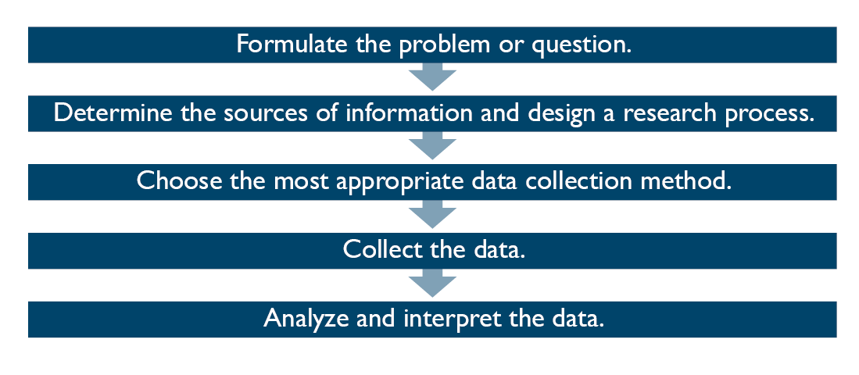
CORE CURRICULUM
The Market Research Process
Source: Adapted and reprinted from Harvard Business School, “Note on Market and Consumer Research,” HBS No. 579-136, by Scott Ward and Dave Reibstein. Copyright © 1979 by the President and Fellows of Harvard College; all rights reserved.
Robert J. Dolan and Leslie K. John, Core Reading: Marketing Intelligence, HBP No. 8191 (Boston: Harvard Business School Publishing, 2019). Copying or posting is an infringement of copyright.

Slide 3
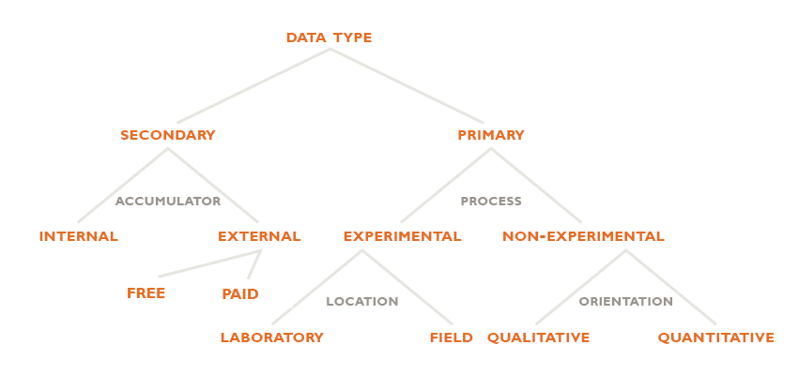
CORE CURRICULUM
Overview of Research Data and Methods
Note: “Accumulator” refers to whether the data were collected from sources internal or external to the company; “process” refers to the methodological procedures by which new insights (i.e., primary data) were collected.
Source: Adapted from Harvard Business School, “Market Research,” HBS No. 592034, by Robert J. Dolan. Copyright © 1991 by the President and Fellows of Harvard College; all rights reserved.
Robert J. Dolan and Leslie K. John, Core Reading: Marketing Intelligence, HBP No. 8191 (Boston: Harvard Business School Publishing, 2019). Copying or posting is an infringement of copyright.

Slide 4
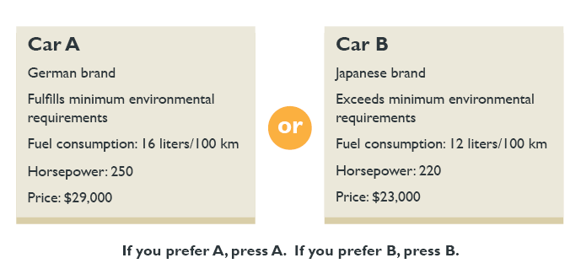
CORE CURRICULUM
Conjoint Analysis: Pairwise Comparison of Car Brands on Bundled Attributes
Source: Adapted and reprinted from Harvard Business School, “Analyzing Consumer Preferences,” HBS No. 599-112, by Robert J. Dolan. Copyright © 1999 by the President and Fellows of Harvard College; all rights reserved.
Robert J. Dolan and Leslie K. John, Core Reading: Marketing Intelligence, HBP No. 8191 (Boston: Harvard Business School Publishing, 2019). Copying or posting is an infringement of copyright.

Slide 5
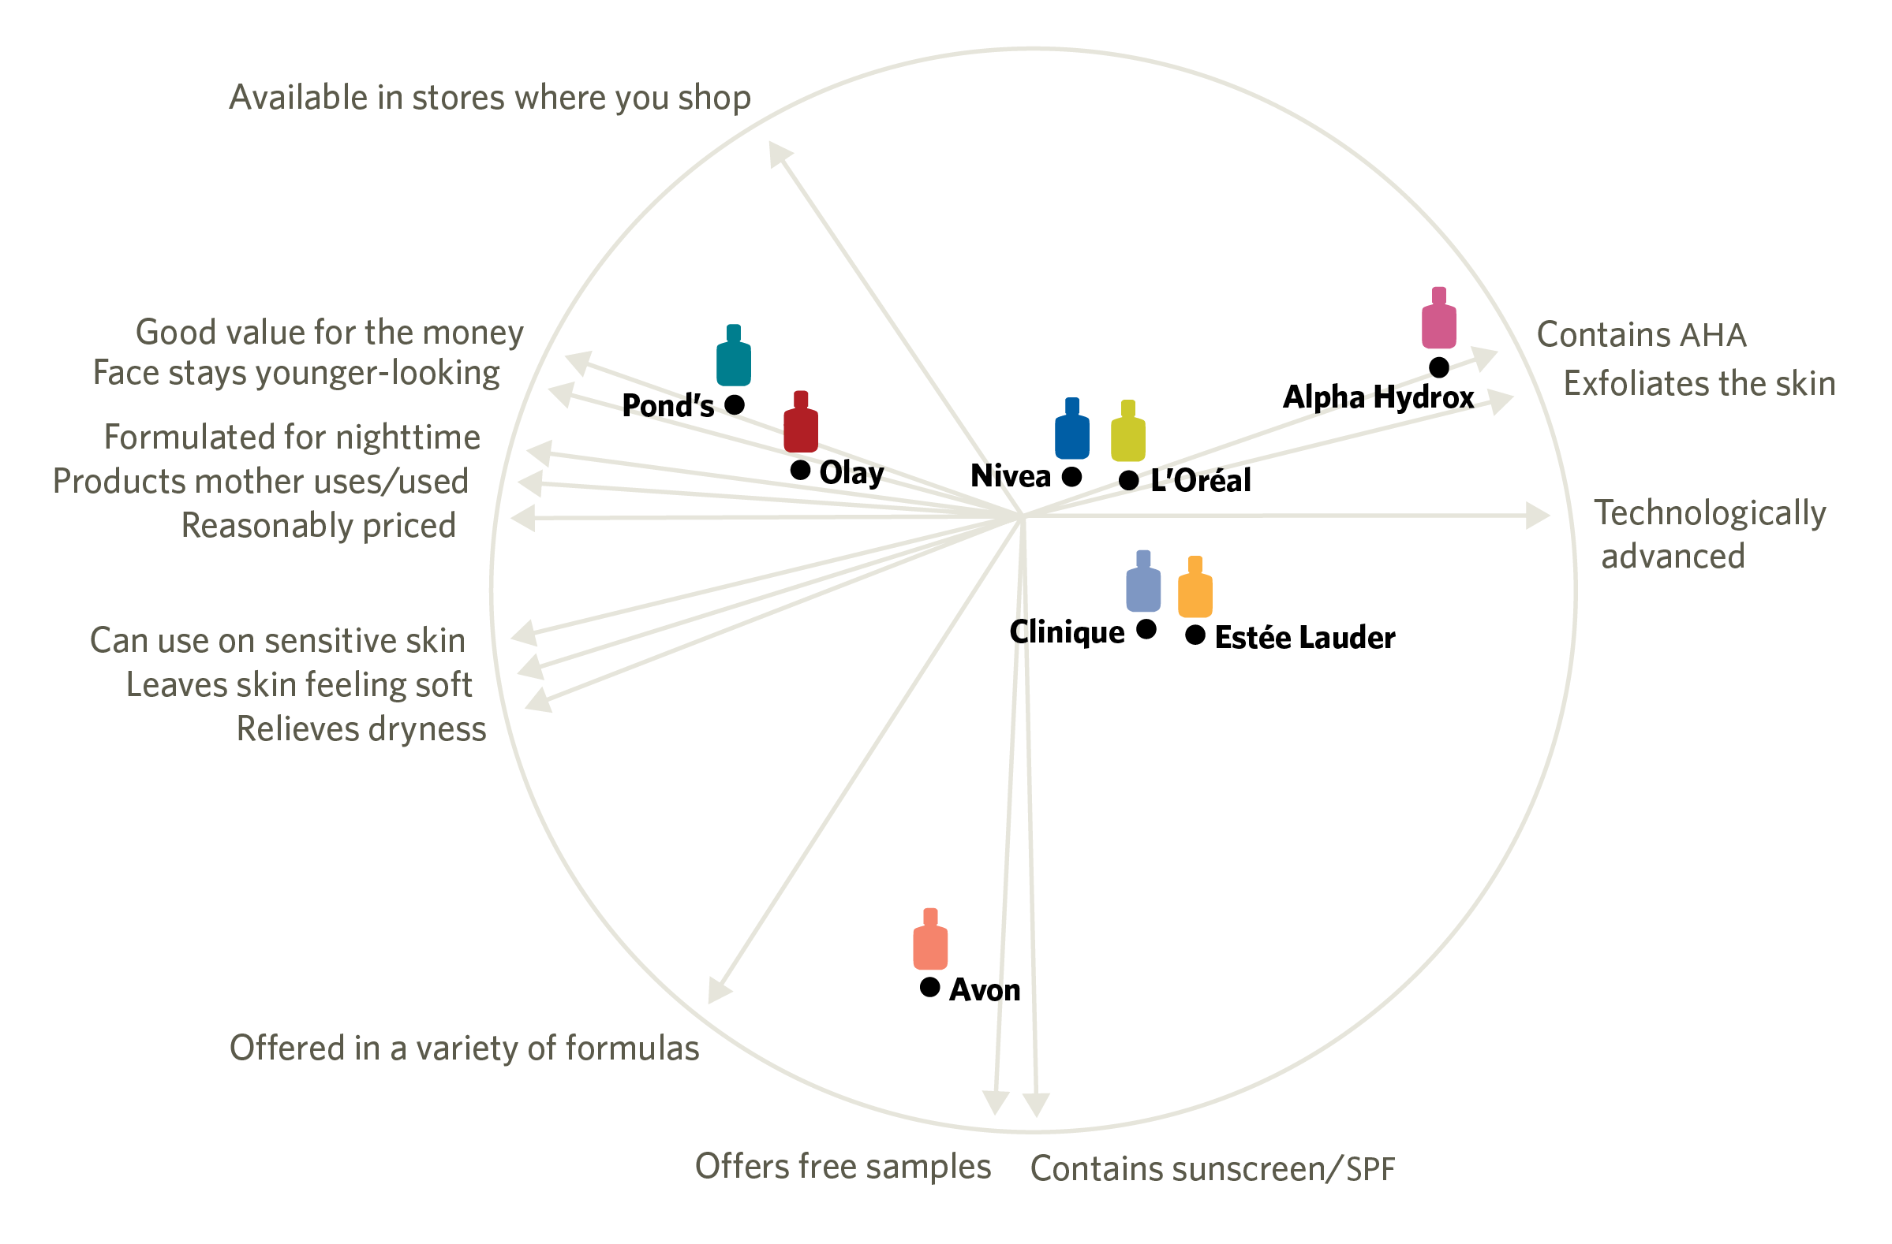
CORE CURRICULUM
L’Oréal’s Perceptual Map of Brand Imagery
Source: Adapted from Harvard Business School, “L’Oréal of Paris: Bringing ‘Class to Mass’ with Plénitude,” HBS No. 598-056, by Robert J. Dolan. Copyright © 1997 by the President and Fellows of Harvard College; all rights reserved.
Robert J. Dolan and Leslie K. John, Core Reading: Marketing Intelligence, HBP No. 8191 (Boston: Harvard Business School Publishing, 2019). Copying or posting is an infringement of copyright.

Slide 6
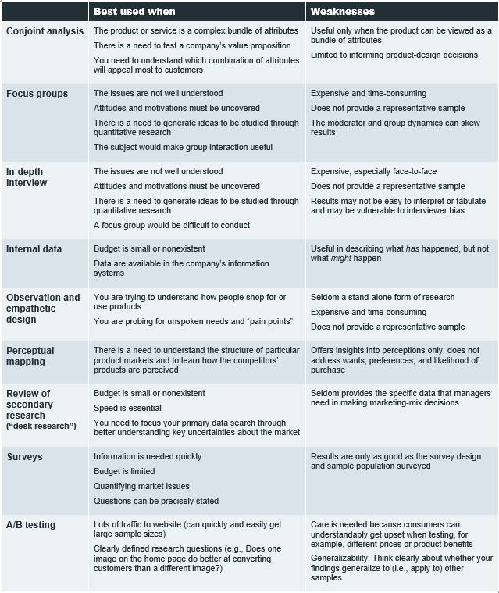
CORE CURRICULUM
Non-experimental Research Methods
Robert J. Dolan and Leslie K. John, Core Reading: Marketing Intelligence, HBP No. 8191 (Boston: Harvard Business School Publishing, 2019). Copying or posting is an infringement of copyright.

